Slide 1
Spacecraft Design
Lunar INterconnection Keepers
Albéric de Lajarte

Slide 2
Presentation
Introduction
Mission overview
System overview
Conclusion
Q/A

Slide 3
Introduction
New emergence of interest for the Moon
NASA Artemis program
ESA HERACLES lander
Private companies
The goal is to go beyond exploration
Lunar base installation
Lunar gateway
Resources exploitation
We need more infrastructure
HERACLES liftoff. Credits: ESA

Slide 4
Mission overview
Create a network of satellite around the Moon to support lunar mission
Low altitude polar orbit relay satellite
L2 Halo orbit relay satellite
Many mores possible …
Test new generation of electric engines
For Moon-Earth transfer
For Moon orbit station keeping
For end of life
Notes:
ESA mission

Slide 5
Mission overview - Transfer
Orbital parameter | Value
Semi-major axis | 21371 km
Eccentricity | 0
Inclination | 28.7°
RAAN | 0°
Argument of perigee | 230°
True anomaly | 270°
Period | 8:38h
Constraints
Minimize maneuvers
Reduce exposition to radiation
Minimize time travel
Solution
Initial circular orbit at 15’000 km altitude
Transfer to highly elliptical orbit with apogee at 347’000km altitude
Cruising on stable manifold
Stabilize to Halo orbit
Phase | DeltaV [m/s] | Duration
MEO insertion | 0 | 3:50h
Manifold insertion | 1207 | 4 years
Cruising | 50 | 60 days
Halo insertion | 0 | -
Station keeping | 518 | 5 years
End of life | 125 | 7 days
Total | 1900 | 9.2 years
Notes:
SOYUZ launch vehicle
Avoid Van Allen 1st bet

Slide 6
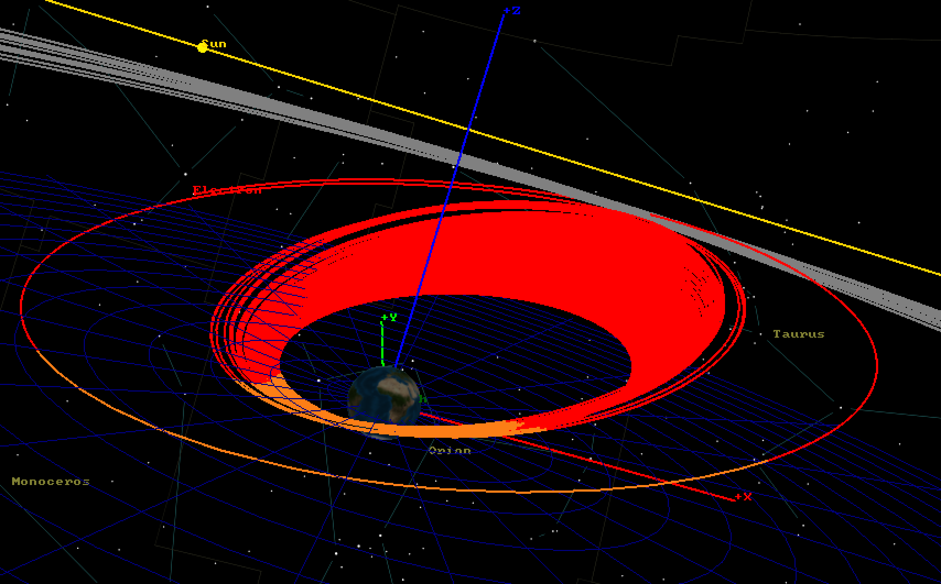

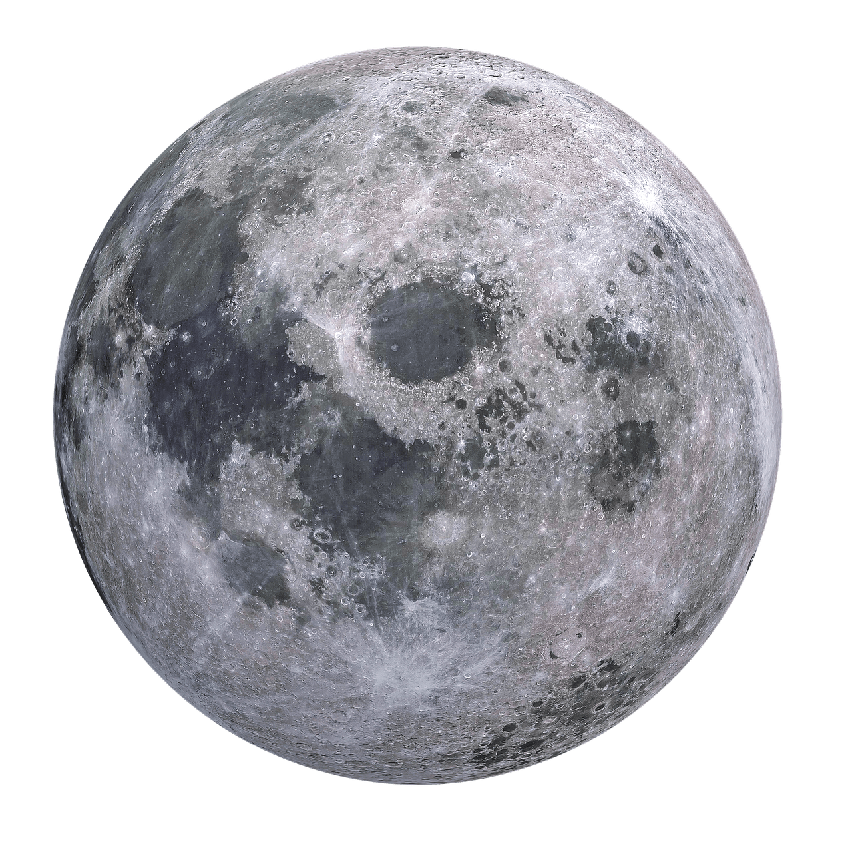
Mission overview - Transfer
Manifold
Transfer orbit
Initial orbit
Halo orbit
Trajectory simulation using GMAT simulator

Slide 7
Mission overview – Final orbit
Far side relay
Continuously relay data between the far side of the Moon and the Earth
Satellite Network
Relay data between the poles and the Earth
Work with polar orbiter
More efficient with more satellite

Slide 8
System overview
System engineering
Telecommunication
Propulsion
Electrical power
ADCS
Structure

Slide 9
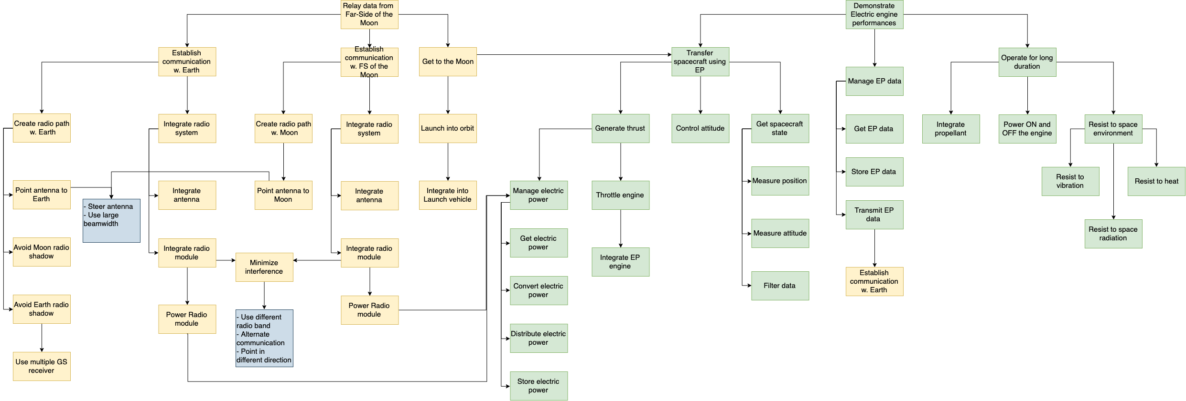
System overview - System engineering
Functional Analysis

Slide 10
System overview - System engineering
Functional Analysis - Telecommunication

Slide 11
System overview - System engineering
Functional Analysis - Propulsion

Slide 12
System overview - System engineering
Functional Analysis – Electrical power

Slide 13
System overview - System engineering
Functional Analysis - ADCS

Slide 14
System overview - System engineering
Functional Analysis - Structure

Slide 15
System overview - System engineering
System diagram

Slide 16
System overview - System engineering
Mass budget
System | Mass [kg]
Structure | 471.5
Propulsion | 430
Telecommunication | 386
Electrical Power | 1072.3
ADCS | 93.6
Total wet mass | 2453.5
Margin | + 811.5

Slide 17
System overview - System engineering
Power budget
Phase | MEO insertion | Manifold insertion |  |  | Station keeping
Mode | Low power | Charge | Thrust | Low power | Relay | Thrust | Low power
Structure | 128,4 | 128,4 | 248,4 | 128,4 | 128,4 | 248,4 | 128,4
Propulsion | 23,4 | 23,4 | 16583,4 | 23,4 | 23,4 | 16583,4 | 23,4
Telecomm. | 21,6 | 21,6 | 21,6 | 21,6 | 7221,6 | 21,6 | 21,6
Elec. Power | 12 | 576 | 1032 | 12 | 576 | 1032 | 0
ADCS | 60 | 60 | 60 | 60 | 60 | 60 | 60
Power IN | 0 | 13’519 | 13’519 | 0,0 | 13’519 | 13’519 | 0,0
Total power [W] | -294,48 | 12’547.8 | -8’015.4 | -294,5 | 3’907.8 | -8’015.4 | -280,1
Duration [h] | 3,83 | 3,5 | 4,3 | 0,9 | 350,4 | 0,0 | 55,3
Battery level [%] | 97,39 | 100,0 | 20,2 | 19,6 | 100,0 | 100,0 | 64,2

Slide 18
System overview - System engineering
Link budget
Link | L2/Earth [dB] |  | L2/Moon [dB]
Emitter | L2 | Earth | L2 | Earth
 | 59,4 | 128,0 | 65,6 | 55,3
Path | -224,6 | -224,6 | -208,1 | -208,1
Receiver | 50,8 | 32,4 | 38,6 | 38,6
SNR | 130,5 | 130,5 | 118,2 | 118,2
Margin | 16,1 | 66,4 | 14,2 | 3,9
Link | L2/Earth [dB]
Emitter | L2 | Earth
 | 14,0 | 117,0
Path | -212,5 | -213,0
Receiver | 37,5 | 6,0
SNR | 164,1 | 164,1
Margin | 3,1 | 74,1
Secondary system
Primary system

Slide 19
System overview - System engineering
Data budget
System | Data rate [kbps]
Structure | 1.13
Propulsion | 23.06
Telecomm. | 0.56
Elec. Power | 3.93
ADCS | 24.56
Total with 30% contingency | 69.21

Slide 20
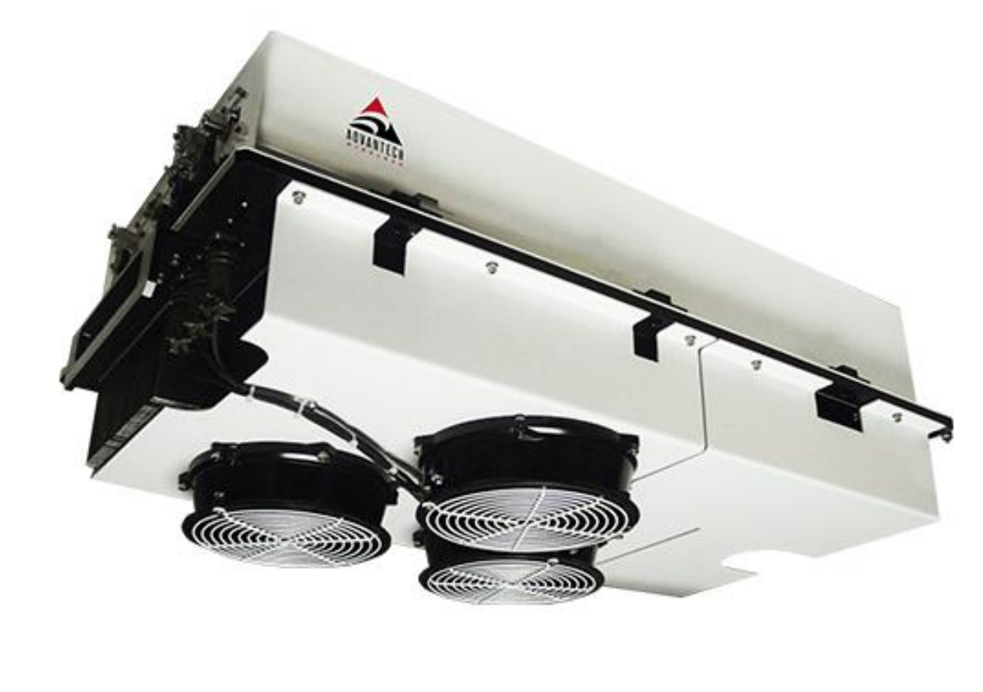
System overview - Telecommunication
Primary system
Goal
Relay data between the Earth and the Moon
Data rate between 1 and 100 Mbps
Use once in Halo orbit
Solution
Two parallel X band systems, one for the Earth, the other for the Moon
Two high gain parabolic antenna
ESTRACK network for the ground station
BPSK with QPSK plus modulation, R-1/2 Viterbi decoding
500 W X band transceiver from Advantech Wireless

Slide 21
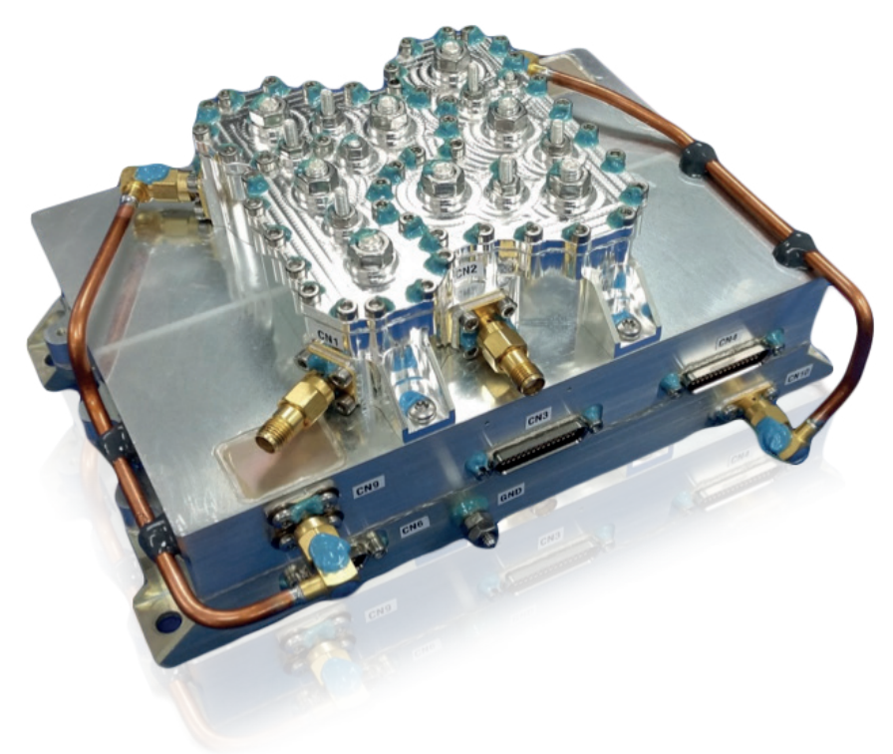
System overview - Telecommunication
Secondary system
Requirement
Transmit internal data of the spacecraft
Backup system for low power mode
Constant link regardless of the attitude
Solution
S band transceiver
2 monopole antenna
3.5 kbps data rate (5% of spacecraft’s data)
ESTRACK network for the ground station
5W S band transceiver from Advantech Wireless

Slide 22
System overview - Telecommunication
Block diagram

Slide 23
System overview - Propulsion
Requirement
Qualify new generation of ion thruster
Used for the transfer to the Moon and the station keeping
Used for desaturation of the CMG
Solution
Two NEXT engine from Glenn Research Center and Aerojet Rocketdyne
Engine mounted on a 2D gimbals
Allow for thrust vectoring and differential thrust
Name | NEXT
Type | Ion engine
Isp | 4190 s
Thrust | 236 mN
Power | 6900 W
Efficiency | 70 %
Mass | 80.89 kg

Slide 24
System overview - Propulsion
Block diagram

Slide 25
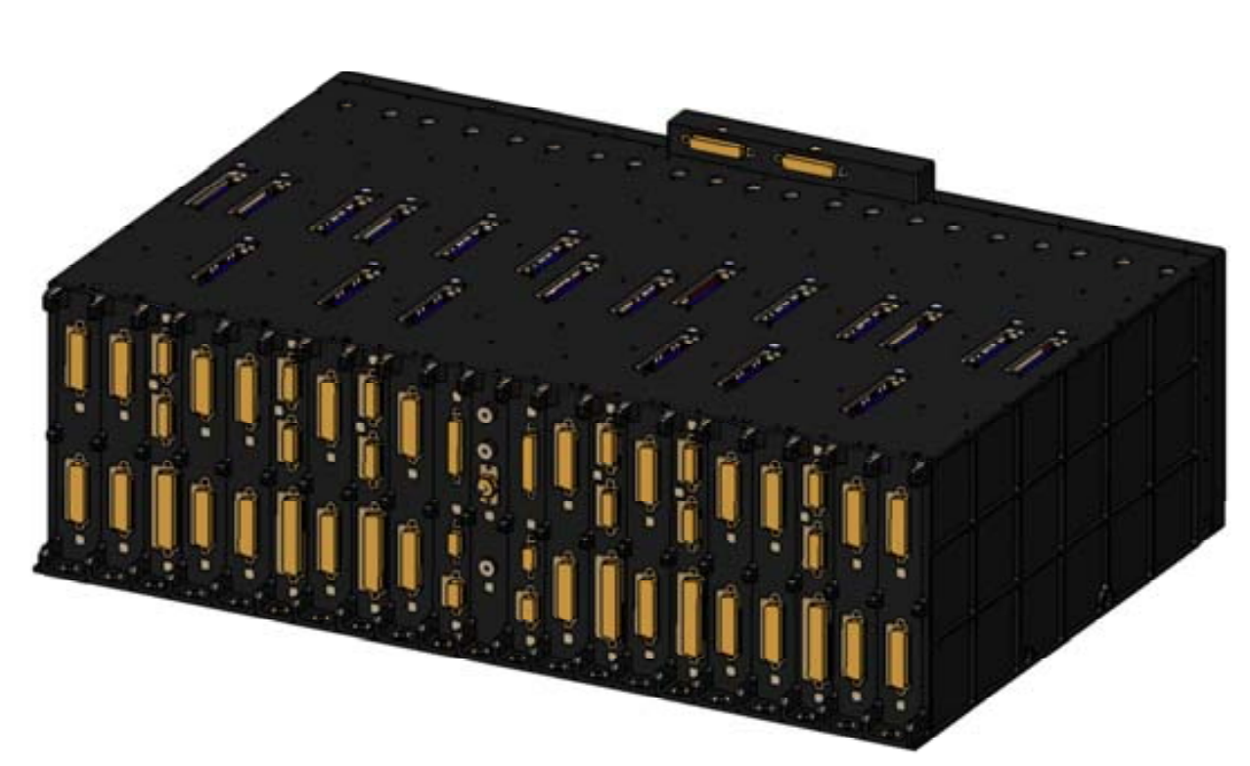
System overview – Electrical Power
Requirements
Power the thrusters
Power the radio transceivers
Manage eclipse phase
Solution
2x6.8 kW Solar panels
43.3 kWh Li-ion battery pack
21 kW Power Conditioning Unit
PCU from Thales Alenia Space

Slide 26
System overview – Electrical Power
Block diagram

Slide 27
System overview – ADCS
Requirements
Estimate and control the attitude of the spacecraft with 0.2° accuracy
Estimate and control the orientation of the Solar panels with 10° accuracy
Transfer 69 kbps of data inside the spacecraft
Store one day of data
Solution
Sensors: star tracker, sun sensor, accelerometer, gyros, GPS, magnetometer
Actuator: 4 Control momentum Gyroscopes, 2 SADA
Federated bus using the CAN protocol
2 redundant 10 Go Flash memory

Slide 28
System overview – ADCS
Block diagram

Slide 29
System overview – Structure
Requirements
Hold the systems together with a maximum acceleration of 4.3g
Protect the spacecraft from thermal variation and overheating
Protect the S/C from cosmic radiation
Solution
Assembly of Honeycomb 76mm thick aluminum panels SF = 0.82
Silver coated FEP surface + MIL for thermal protection
Final dimensions of 1.4x1.4x3.1 meters (without Solar panels)

Slide 30
System overview – Structure

Slide 31
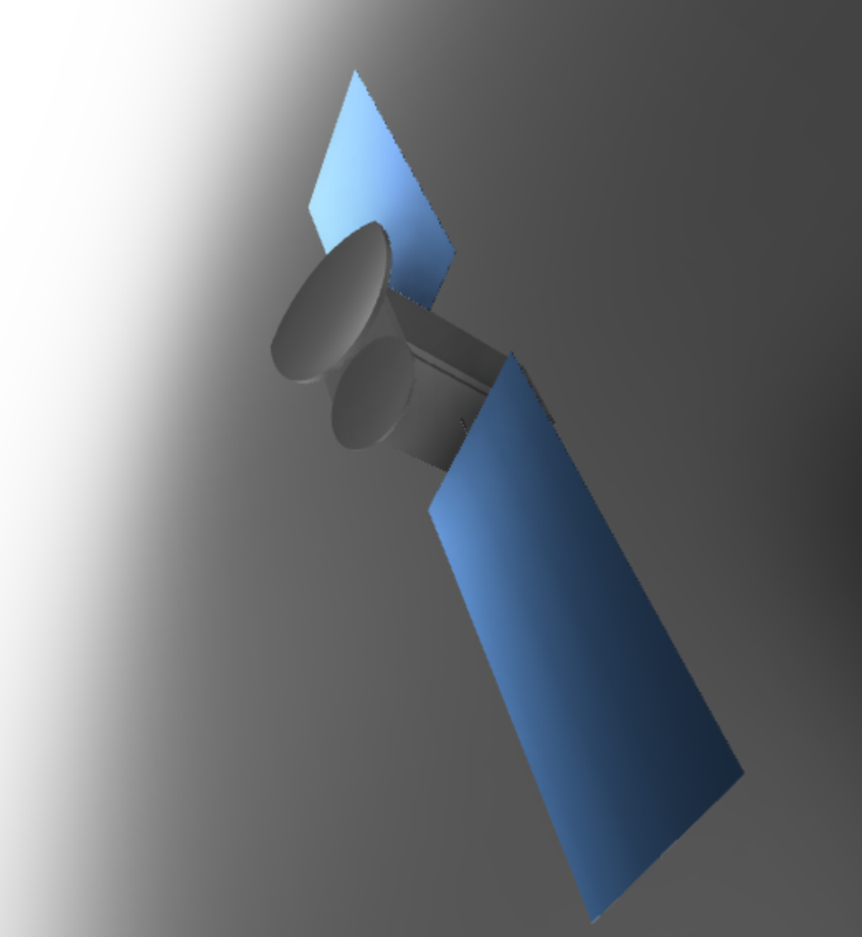
Conclusion
Overall Spacecraft successfully implemented
Very good learning opportunity
Transfer time not optimized enough
Collaboration with other lunar mission could have been better implemented

Slide 32
THANK YOU FOR YOUR ATTENTION!
Discussion

